Slide 2
HNDIT2302 IT Project Management
Project Risk Management

Slide 3
Learning Objectives
Discuss the importance of good project risk management
Discuss the risk management processes
Identify tools and techniques available for risk management.
Describe different risk response planning strategies.

Slide 4
What is Risk?
A dictionary definition of risk is “the possibility of loss or injury”
Project risk involves understanding potential problems that might occur on the project and how they might impede project success
Risk management is like a form of insurance; it is an investment

Slide 5
Project Risk Management
Risk Management is the systematic process of identifying, analyzing, and responding to project risk.
The major processes in Project Risk Management :
Risk Management Planning
Risk Identification
Qualitative Risk Analysis
Quantitative Risk Analysis
Risk Response Planning
Risk Monitoring and Control

Slide 6
Risk Management Planning
Risk management planning is deciding how to approach and plan the risk management activities for the project.
Inputs to risk management planning- project charter, WBS, defined roles and responsibilities, stake holder risk tolerances, etc.
The main output of risk management planning is a risk management plan
The project team should review project documents and understand the organization’s and the sponsor’s approach to risk
The level of detail will vary with the needs of the project

Slide 7
Risk Identification
Risk identification is the process of understanding what potential unsatisfactory outcomes are associated with a particular project
Several risk identification tools and techniques include
Brainstorming
Check lists
The Delphi technique
Interviewing
SWOT analysis

Slide 8
Software project risks and strategies for risk reduction
Risk | Risk reduction techniques
Personnel shortfalls | Staffing with top talent, job matching, teambuilding, training and career development, early scheduling of key personal
Unrealistic time and cost estimates | Multiple estimation techniques, design to cost, incremental development, recording and analysis of past projects, standardization of methods.
Developing the wrong software functions | Improved software evaluation, formal specification methods, user surveys, prototyping, early user manuals
Developing the wrong user interface | Prototyping, task analysis, user involvement

Slide 9
Software project risks and strategies for risk reduction, Cont.’
Risk | Risk reduction techniques
Late changes to requirements | Stringent change control procedures, high change threshold, incremental development
Shortfalls in extremely supplied components | Benchmarking, inspections, formal specifications, contractual agreements ,quality assurance procedures and certification.
Shortfalls in extremely performed tasks | Quality assurance procedures, competitive design or prototyping, contract incentives
Real-time performance shortfalls | Simulation, benchmarking, prototyping, tuning, technical analysis

Slide 10
Qualitative Risk Analysis
Performing a qualitative analysis of risk and conditions to prioritize their effects on project objectives.
Assess the likelihood and impact of identified risks to determine their magnitude and priority.
Risk quantification tools and techniques include
Probability/Impact matrixes
The Top 10 Risk Item Tracking technique
Expert judgment

Slide 11
Quantitative Risk Analysis
Often follows qualitative risk analysis, but both can be done together or separately
Large, complex projects involving leading edge technologies often require extensive quantitative risk analysis
Main techniques include
decision tree analysis
simulation

Slide 12
Risk Response Planning
After identifying and quantifying risks, you must decide how to respond to them
Four main strategies:
Risk avoidance: eliminating a specific threat or risk, usually by eliminating its causes
Risk acceptance: accepting the consequences should a risk occur
Risk transference: shifting the consequence of a risk and responsibility for its management to a third party
Risk mitigation: reducing the impact of a risk event by reducing the probability of its occurrence

Slide 13
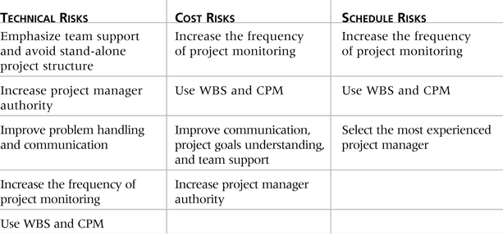
General Risk Mitigation Strategies for Technical, Cost, and Schedule Risks

Slide 14
Risk Monitoring and Control
Monitoring risks involves knowing their status
Controlling risks involves carrying out the risk management plans as risks occur
Workarounds are unplanned responses to risk events that must be done when there are no contingency plans
The main outputs of risk monitoring and control are corrective action, project change requests, and updates to other plans

Slide 15
Risk Response Control
Risk response control involves executing the risk management processes and the risk management plan to respond to risk events
Risks must be monitored based on defined milestones and decisions made regarding risks and mitigation strategies
Sometimes workarounds or unplanned responses to risk events are needed when there are no contingency plans

Slide 16
Using Software to Assist in Project Risk Management
Databases can keep track of risks. Many IT departments have issue tracking databases
Spreadsheets can aid in tracking and quantifying risks
More sophisticated risk management software, such as Monte Carlo simulation tools, help in analyzing project risks

Slide 17
References
“Information Technology Project Management”, Kathy Schwalbe, sixth Edition, THOMSON Course Technology

